Slide 1
Unit 2 : Creating a Microsoft ASP.NET Web Form

Slide 2
Overview
Creating Web Forms
Using Server Controls

Slide 3
Creating Web Forms
What is a Web Form?
Creating a Web Form with Visual Studio .NET
Demonstration: Converting an HTML Page to a Web Form
Notes:
Demonstration: giảng dậy, Trình diễn

Slide 4
What Is a Web Form?
.aspx extension
Page attributes
@ Page directive
Body attributes
Form attributes
<%@ Page Language="vb" Codebehind="WebForm1.aspx.vb" SmartNavigation="true"%>
<html>
<body ms_positioning="GridLayout">
<form id="Form1" method="post" runat="server">
</form>
</body>
</html>

Slide 5
Creating a Web Form with Visual Studio .NET
New ASP.NET Web Applications create a default Web Form: WebForm1.aspx
Create additional Web Forms from the Solution Explorer
Upgrade existing HTML pages into Web Forms
Notes:
Upgrade: nâng cấp

Slide 6

Demonstration: Converting an HTML Page to a Web Form
Change .htm extension to .aspx extension

Slide 7
Lesson: Using Server Controls
What is a Server Control?
Types of Server Controls
Saving View State
Demonstration: Converting HTML Controls to Server Controls
HTML Server Controls
Web Server Controls
Practice: Identifying the HTML Generated by Web Server Controls
Selecting the Appropriate Control
Demonstration: Adding Server Controls to a Web Form
Notes:
Indentifying: Xác định, Khám phá, Generated: Tạo ra, Approproate Control: Điều khiển đặc biệt

Slide 8
What is a Server Control?
<asp:Button id="Button1" runat="server"
Text="Submit"/>
Runat="server"
Events happen on the server
View state saved
Have built-in functionality
Common object model
All have Id and Text attributes
Create browser-specific HTML
Notes:
Have Built-in Functionality: Đã tích hợp chức năng, Create Browser-Specific HTML: Tạo ra trình duyệt cụ thể HTML

Slide 9
Types of Server Controls
HTML server controls
Web server controls
Intrinsic controls
Validation controls
Rich controls
List-bound controls
Internet Explorer Web controls
Notes:
Intrinsic: Nội tại, Validation: Xác nhận

Slide 10
Saving View State
Hidden ViewState control of name-value pairs stored in the Web Form
On by default, adjustable at Web Form and control level
<input type="hidden" name="__VIEWSTATE" value="dDwtMTA4MzE0MjEwNTs7Pg==" />
<%@ Page EnableViewState="False" %>
<asp:ListBox id="ListName" EnableViewState="true" runat="server">
</asp:ListBox>

Slide 11
Demonstration: Converting HTML Controls to Server Controls
Upgrade HTML controls to HTML server controls
Add a Web server control
Use SmartNavigation

Slide 12
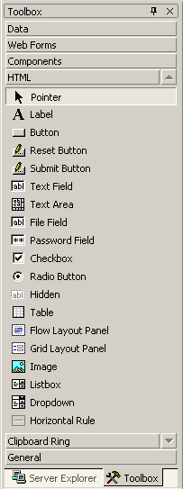
HTML Server Controls
Based on HTML elements
Exist within the System.Web.UI.HtmlControls namespace
<input type="text" id="txtName" runat="server" />

Slide 13
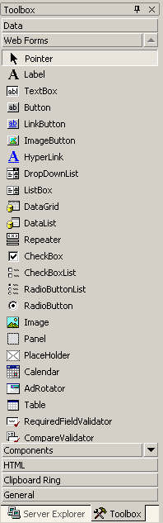
Web Server Controls
Exist within the System.Web.UI.WebControls namespace
Control syntax
HTML that is generated by the control
<asp:TextBox id="TextBox1"
runat="server">Text_to_Display
</asp:TextBox>
<input name="TextBox1" type="text"
value="Text_to_Display"
Id="TextBox1"/>
Notes:
Generated: Tạo ra

Slide 14

Practice: Identifying the HTML Generated by Web Server Controls
Students will:
Add Web server controls to a Web Form and identify the HTML that is sent to a client
Time: 5 Minutes
Notes:
Generated: Tạo ra
Identify: Xác định

Slide 15
Selecting the Appropriate Control
Use HTML Server Controls if:
Use Web Server Controls if:
You prefer an HTML-like object model
You prefer a Visual Basic-like programming model
You are working with existing HTML pages and want to quickly add ASP.NET Web page functionality
You are writing a page that might be used by a variety of browsers
The control will interact with client and server script
You need specific functionality such as a calendar or ad rotator
Bandwidth is limited
Bandwidth is not a problem
Notes:
Appropriate: Thích hợp, Interact: Tương tác

Slide 16
Demonstration: Adding Server Controls to a Web Form
Create a Web Form
Add TextBox, Button, and Label controls
Add a Calendar control

Slide 17
DEMO
Run in IE
Lesson03.2_Postback form.swf

